Slide 1
Students, Courses & Registration System
A Group Project Presentation Web-based Registration Portal | Blueprint System Design
Presented by: ALPHA GROUP
Group members: desmond antwi, PRINCE YEBOAH, Carlos Agbevadi, Segbedzi Kennedy, ISSAHAKU SUMAILA, joy & freeman

Slide 2
Introduction / Overview
Project Overview Content:
A web-based student registration portal for Alpha Group.
Enables students to submit registration details.
Admin approval before student data is fully accepted.
Built with PHP, MySQL, HTML, CSS.

Slide 3
Objectives
Project Objectives Content:
Automate student registration process.
Store student data securely in a database.
Provide a user-friendly registration form.
Reduce manual data entry for administrators.

Slide 4
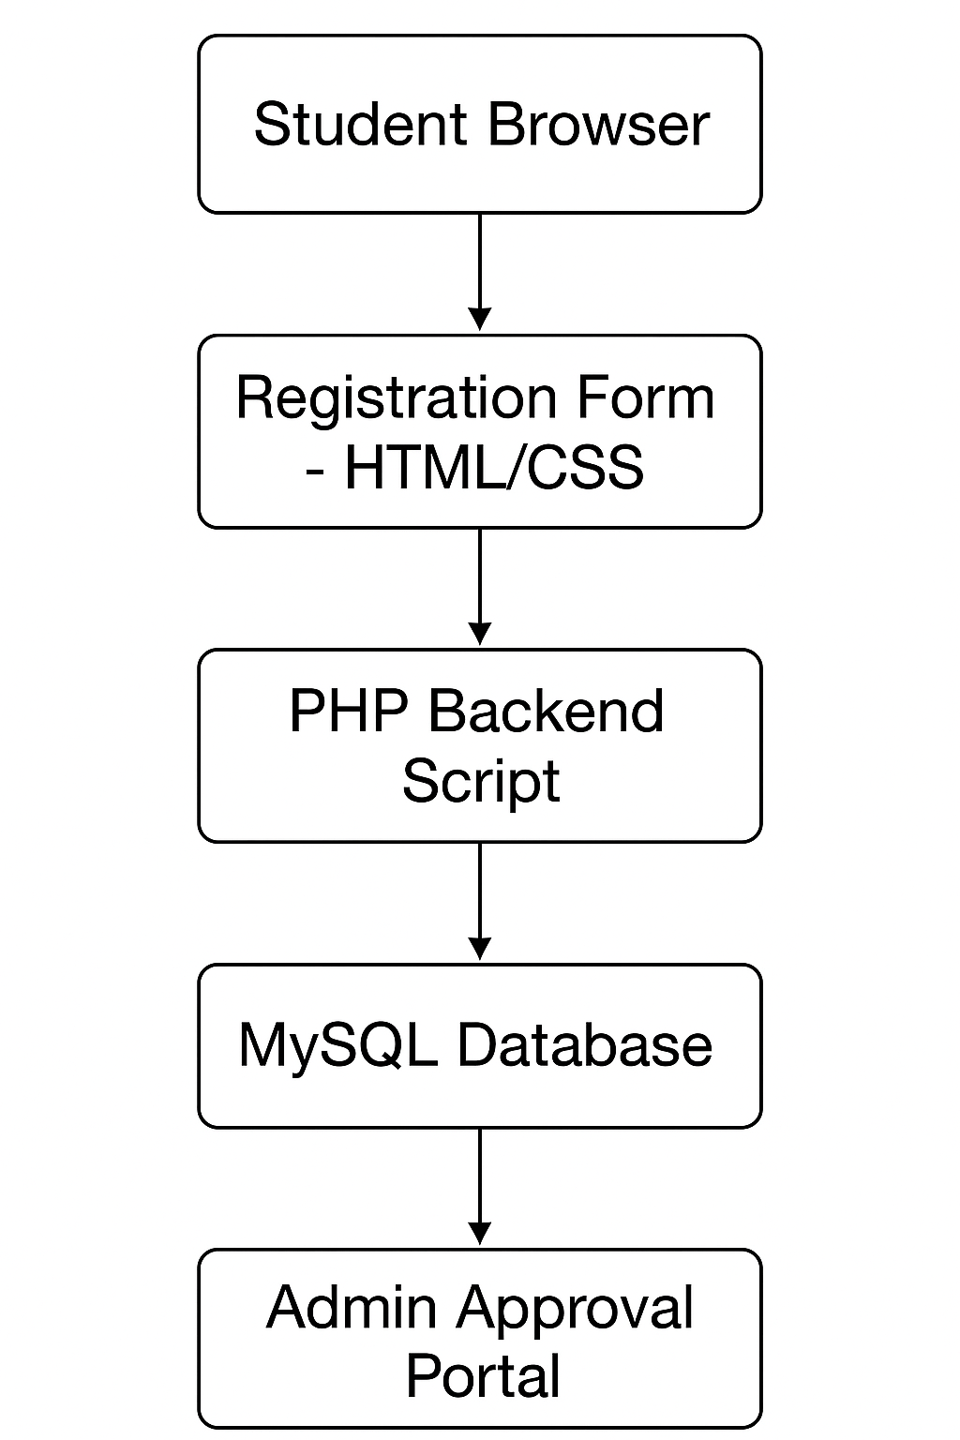
Technology Stack

Slide 5
Layer | Technology
Backend | PHP, MySQL
Frontend | HTML, CSS, JavaScript
Database | MySQL
Deployment | Localhost / Web Server
Optional Tools | XAMPP, VS Code

Slide 6
System Architecture
System Architecture Content / Diagram:
User fills registration form → Form data sent via POST → PHP script processes data → MySQL database stores student info → Admin reviews/approves.

Slide 7
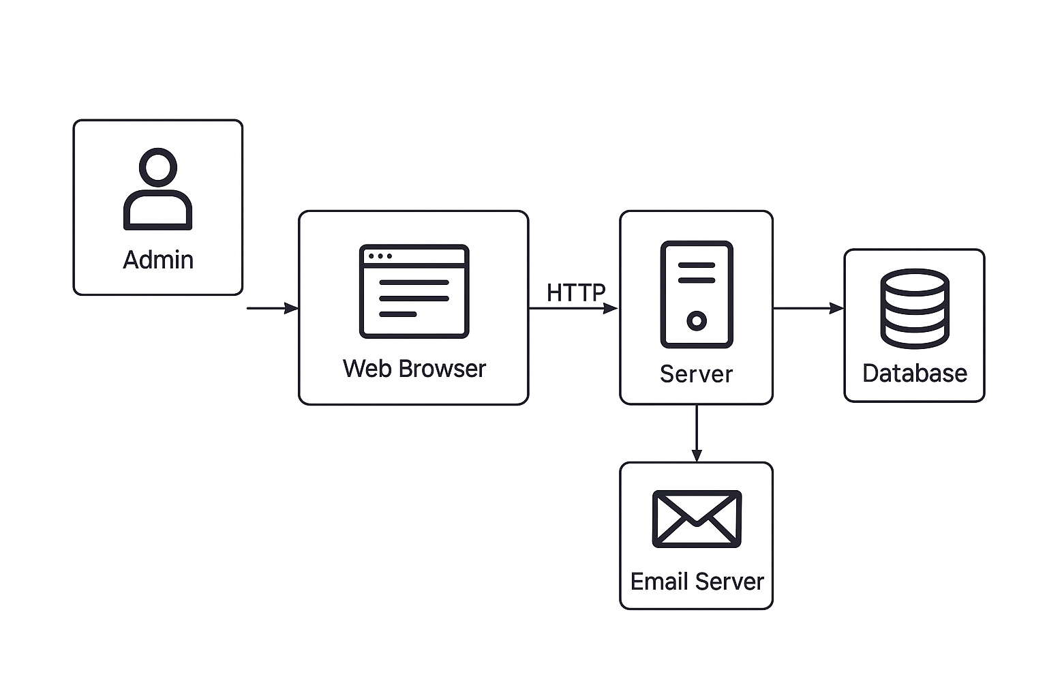
Simple flowchart:

Slide 8
Database Design - Database Table – students
Title: Database Table – students Content:
Field | Type | Description
id | INT | Primary Key, Auto Increment
fullname | VARCHAR | Student’s full name
email | VARCHAR | Student’s email
phone | VARCHAR | Student’s phone number
address | VARCHAR | Student address
gender | VARCHAR | Male/Female/Other
course | VARCHAR | Selected course
qualification | VARCHAR | Education level

Slide 9
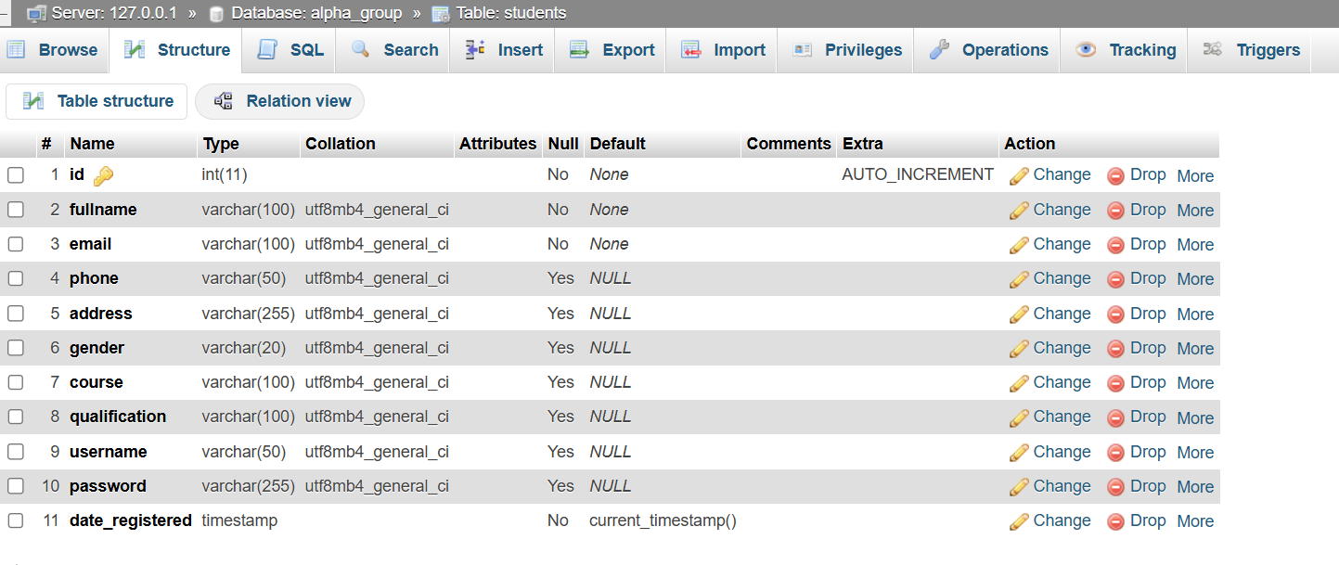
Simple flowchart:

Slide 10
Frontend (HTML/CSS) Title: STUDENT Registration Form
Clean UI with two-column layout.
Left: Info + login button.
Right: Registration form with required fields.
Responsive and user-friendly design.

Slide 11
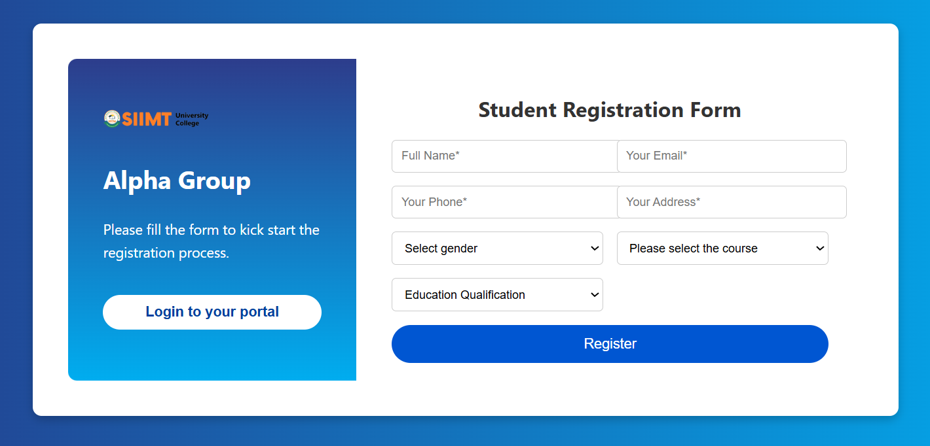
Visual: Screenshot of the registration page.

Slide 12
PHP Backend (Code Explanation)
PHP Backend Functionality Content:
Connects to MySQL using mysqli.
Handles form submission with $_POST.
Sanitizes input with htmlspecialchars().
Prepares SQL statements to insert data into students table.
Provides success/failure alerts.

Slide 13
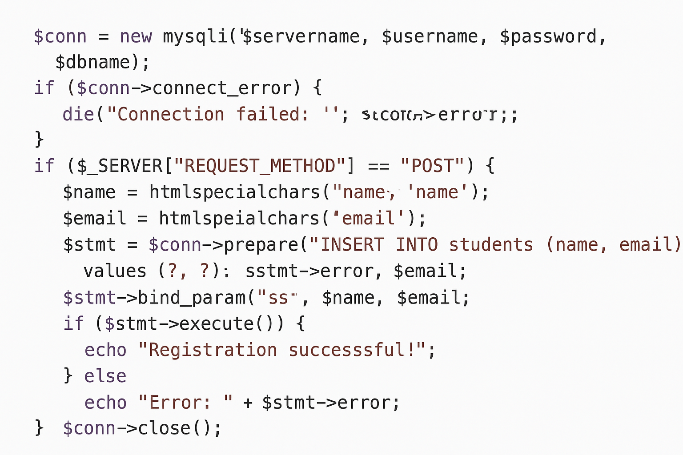
snippet of the PHP code

Slide 14
User Flow
Student accesses registration page.
Fills form → submits.
PHP validates & stores data in DB.
Admin reviews & approves registration.
Student receives confirmation.

Slide 15
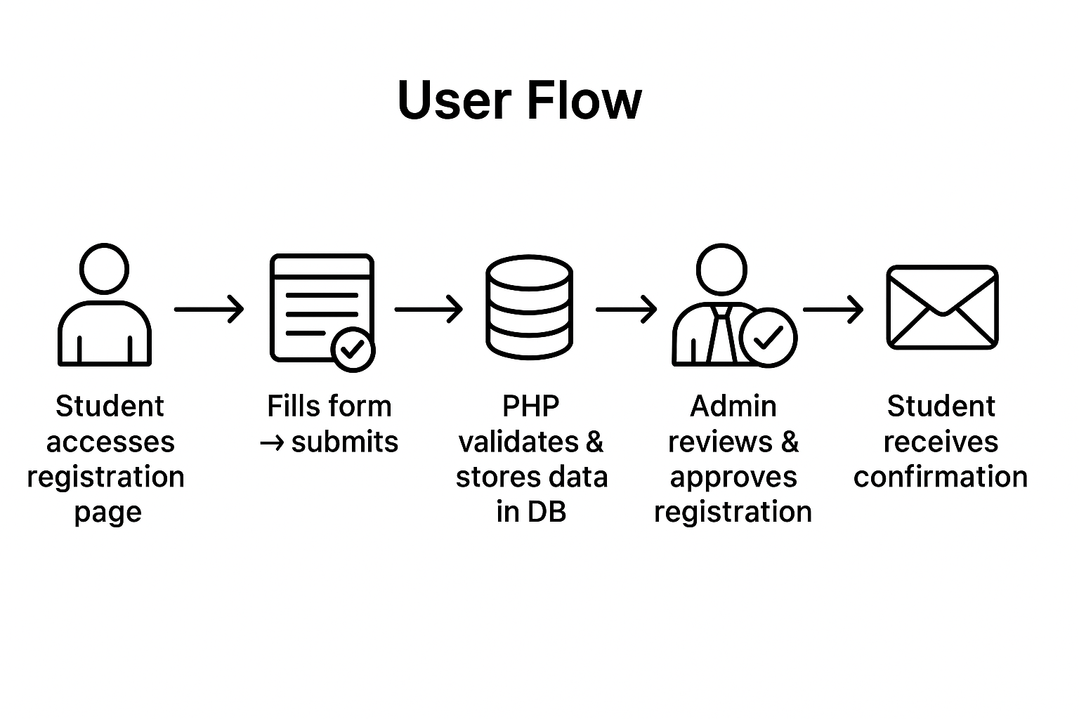
Diagram:

Slide 16
Admin Dashboard - Manage Students
Once the student has completed the form,
The admin will create a username and password for the student to log in.

Slide 17
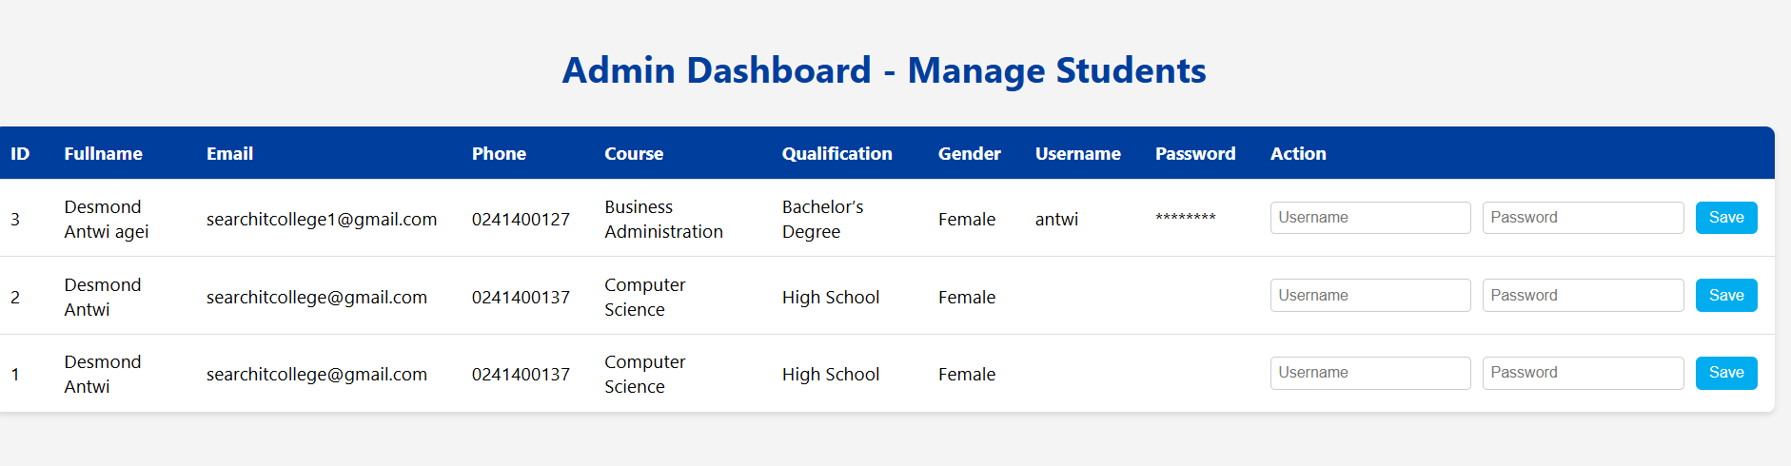
Work flow

Slide 18
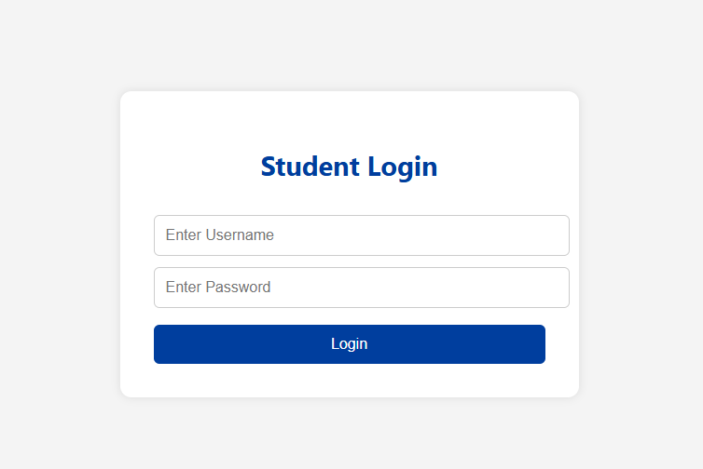
Student Login

Slide 19
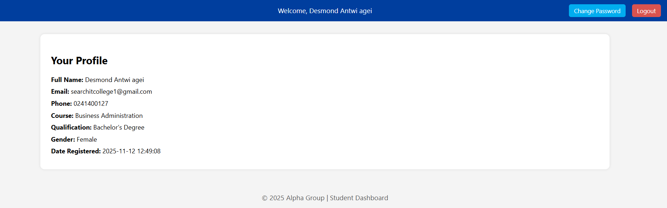
Student dashboard

Slide 20
Summary & Conclusion
The Students, Courses & Registration System provides a foundation for academic record management.
Key Takeaways:
PHP and MySQL integration ensures dynamic data handling
Clear architecture supports scalability
Database normalization improves consistency

